Slide 1
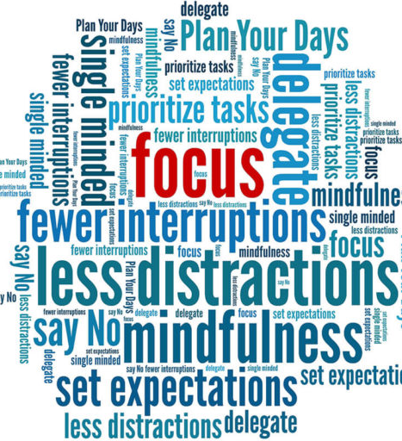

Time Management
Anne T. Melvin
Dynamic Fundraising Training
August 2023

Slide 2

Notes:
https://www.youtube.com/watch?v=zV3gMTOEWt8

Slide 3
The Analogy of the Big Rocks
What were the all big rocks?
What were the little green pebbles?

Slide 4
Stephen Covey’s Time Matrix: Quadrant 1
Quadrant 2
Quadrant 3
Quadrant 4
Email
Reaching Time Nirvana

Slide 5
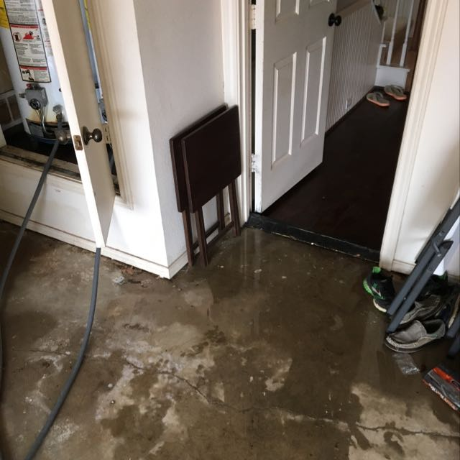
Broken Water Heater
Where do you find the time to fix it?
Notes:
7.5 hours over a week to deal with an emergency at home
You MAKE the time
How do you make the time? You make it a priority

Slide 6
Answer this question:
What are the top three ways you spend your time (bullet points)
Examples:
Meetings that are useful
Answering/sending email
Talking with donors
Determining what I’m going to work on that day/week/month
Activities that refresh and rejuvenate me in my personal time
Working on special projects outside my job

Slide 7
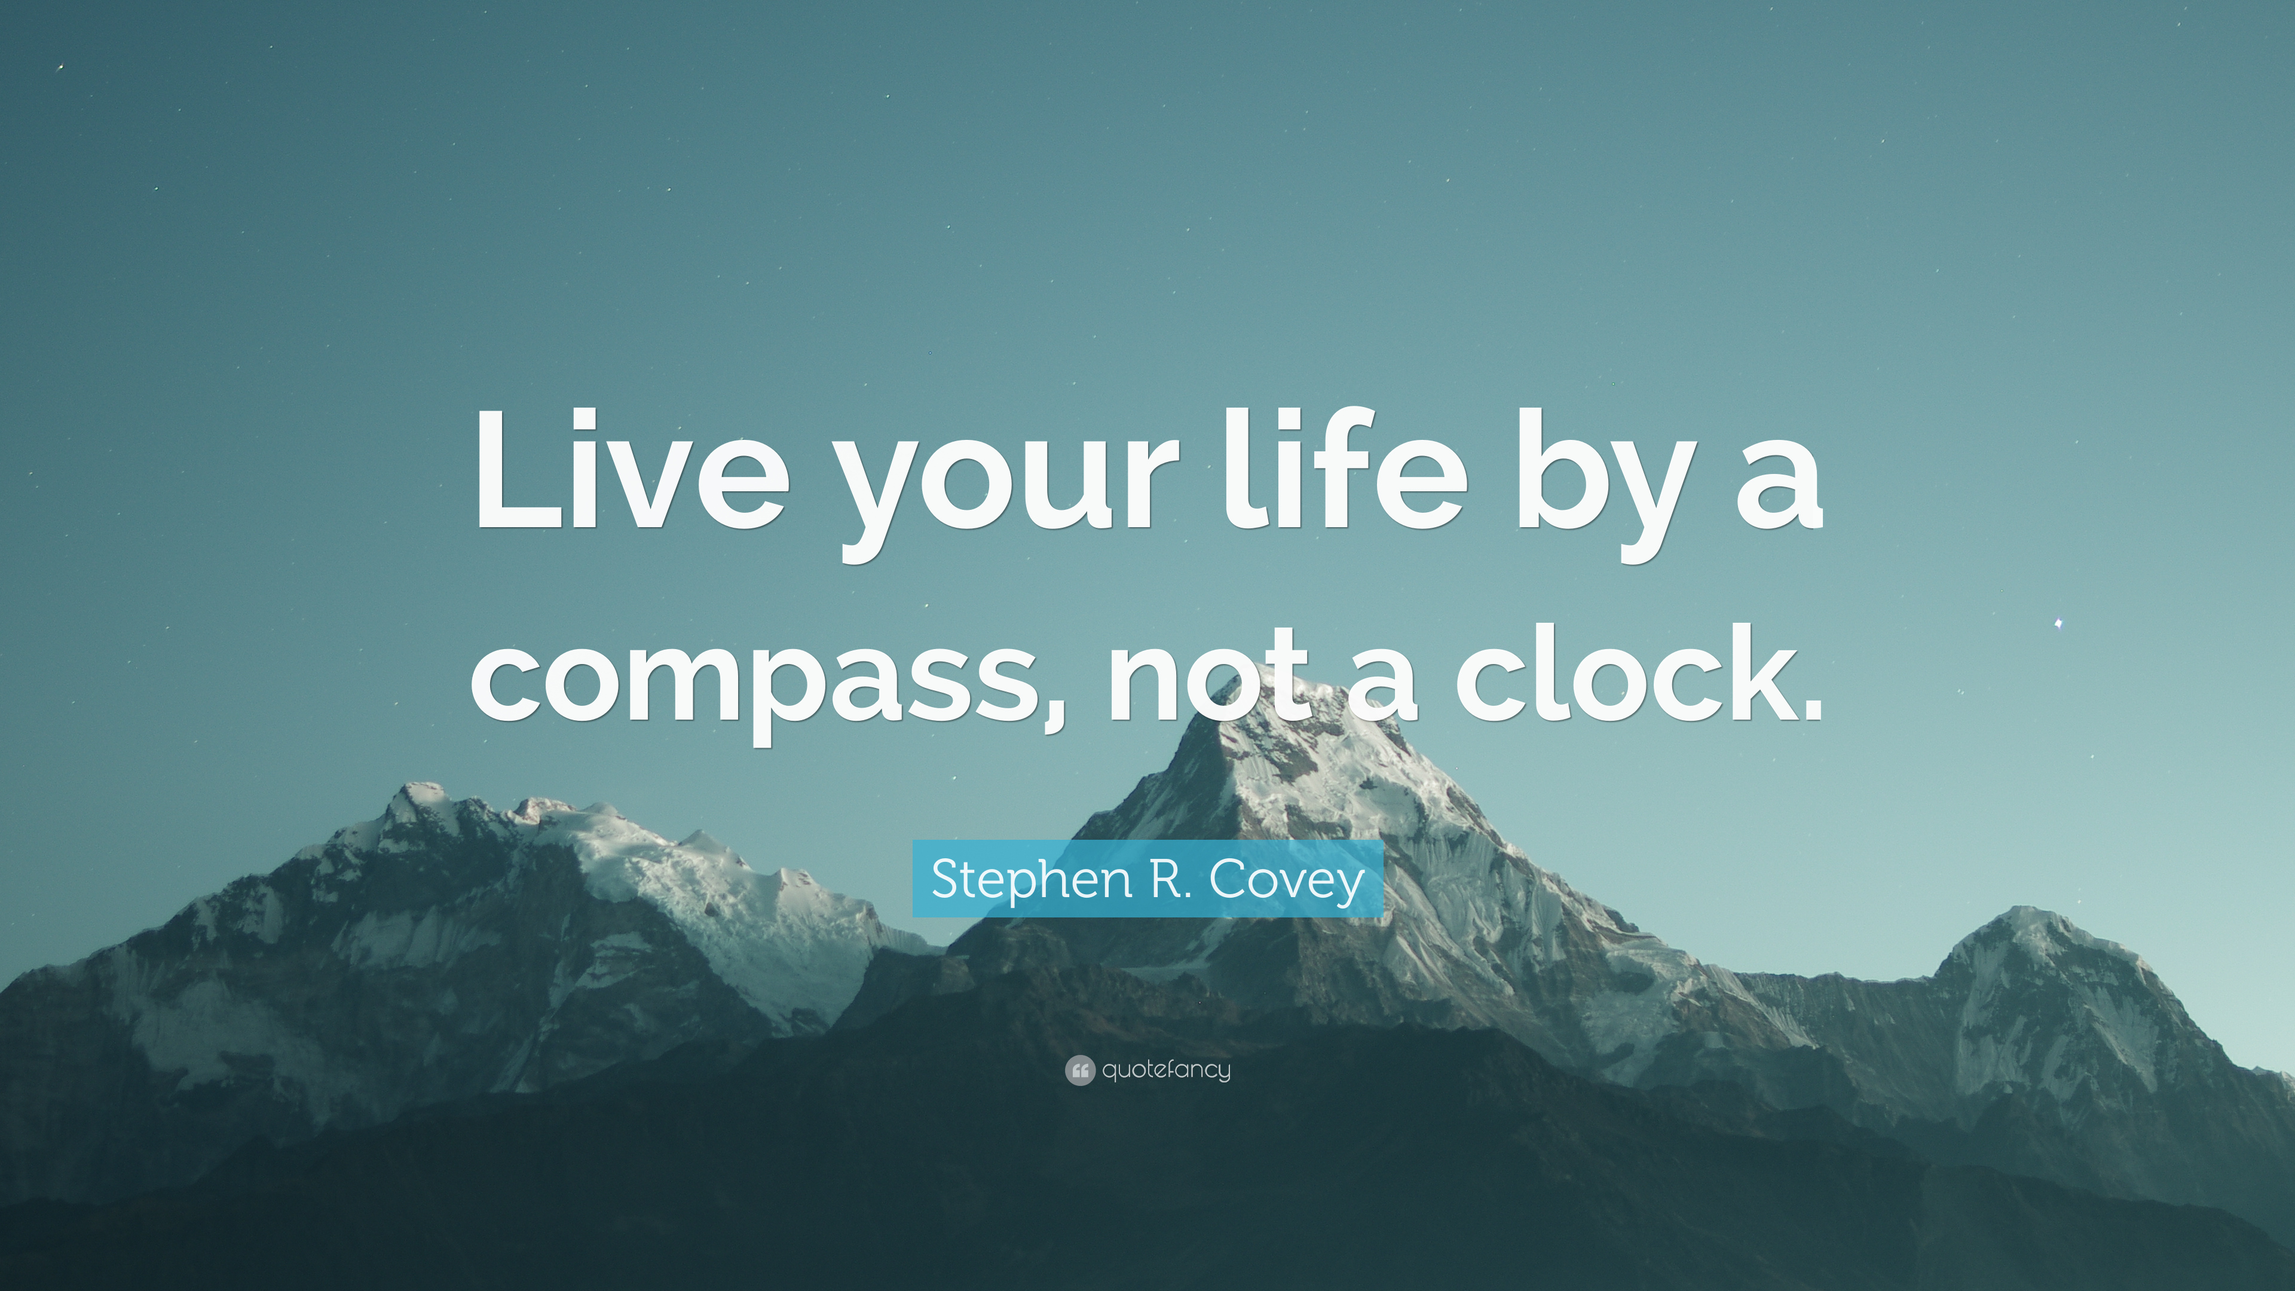
Is this the most valuable way you SHOULD be spending your time?

Slide 8
Is this the most valuable way you should be spending your time?
Shift from doing what’s IN FRONT OF YOU to what is IMPORTANT

Slide 9
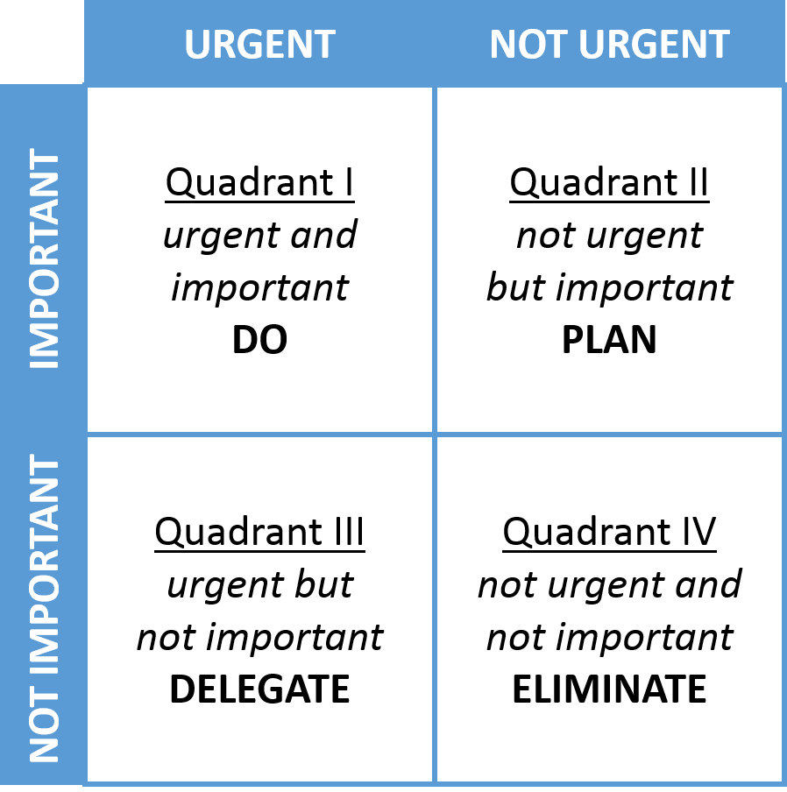
Stephen Covey’s Time Matrix
Quadrant One

Slide 11
 | Time Matrix
 | Urgent | Not Urgent
Important | I CRISIS: Manage (5%) Crisis Medical emergencies Last minute preparations for scheduled activities | II FOCUS: Big Rocks (75%) Preparation/Planning Large chunks of 'big rock' work Clarifying values: what will move the needle? Exercise Relationship-building True relaxation and recreation
Not Important | III DECEPTION: Avoid (15%) Some meetings Constantly turning to emails 'Pressing'…to other people Interruptions Boss musing to you Projects that feel important but don't move the needle | IV WASTE: Limit (5%) Busy work Excessive socializing or relaxing Trivia People wasting your time

Slide 12
Stephen Covey’s Time Matrix
Quadrant Two
BIG ROCKS
Clarifying values

Slide 13
 | Time Matrix
 | Urgent | Not Urgent
Important | I CRISIS: Manage (5%) Crisis Medical emergencies Last minute preparations for scheduled activities | II FOCUS: Big Rocks (75%) Preparation/Planning Large chunks of 'big rock' work Clarifying values: (what will move the needle?) Exercise Relationship-building True relaxation and recreation
Not Important | III DECEPTION: Avoid (15%) Some meetings Constantly turning to emails 'Pressing'…to other people Interruptions Boss musing to you Projects that feel important but don't move the needle | IV WASTE: Limit (5%) Busy work Excessive socializing or relaxing Trivia People wasting your time

Slide 14
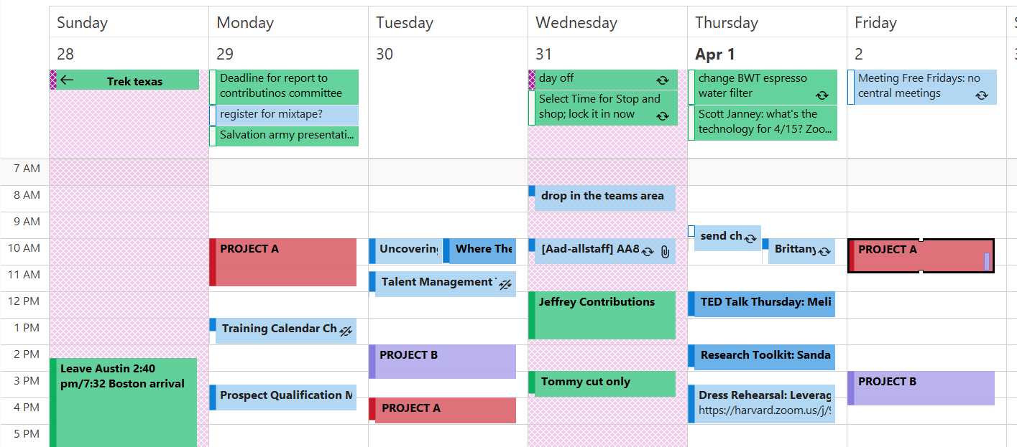
‘Put the Big Rocks in first…’

Slide 15
 | Time Matrix
 | Urgent | Not Urgent
Important | I CRISIS: Manage (5%) Crisis Medical emergencies Last minute preparations for scheduled activities | II FOCUS: Big Rocks (75%) Preparation/Planning Large chunks of 'big rock' work Clarifying values: (what will move the needle?) Exercise Relationship-building True relaxation and recreation
Not Important | III DECEPTION: Avoid (15%) Some meetings Constantly turning to emails 'Pressing'…to other people Interruptions Boss musing to you Projects that feel important but don't move the needle | IV WASTE: Limit (5%) Busy work Excessive socializing or relaxing Trivia People wasting your time

Slide 16
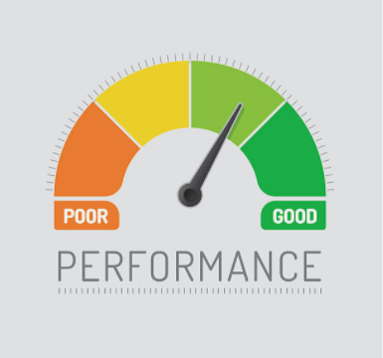
Clarifying Values: What’s going to move the needle?
Make a list
Look back
Ask the question
3-5 priorities: are they the same?

Slide 17

Top 3-5 Priorities
What are YOUR top 3-5 priorities at work? Things you can control?
Notes:
Ask audience to take 2 minutes to write out their top 3 work priorities: clarifying values. Give example for a fundraiser

Slide 18

Stephen Covey’s Time Matrix
Quadrant three
DECEPTION!

Slide 19
 | Time Matrix
 | Urgent | Not Urgent
Important | I CRISIS: Manage (5%) Crisis Medical emergencies Last minute preparations for scheduled activities | II FOCUS: Big Rocks (75%) Preparation/Planning Large chunks of 'big rock' work Clarifying values: what will move the needle? Exercise Relationship-building True relaxation and recreation
Not Important | III DECEPTION: Avoid (15%) Some meetings Constantly turning to emails 'Pressing'…to other people Interruptions Boss musing to you Projects that feel important but don't move the needle | IV WASTE: Limit (5%) Busy work Excessive socializing or relaxing Trivia People wasting your time

Slide 20
 | Time Matrix
 | Urgent | Not Urgent
Important | I CRISIS: Manage (5%) Crisis Medical emergencies Last minute preparations for scheduled activities | II FOCUS: Big Rocks (75%) Preparation/Planning Large chunks of 'big rock' work Clarifying values: (what will move the needle?) Exercise Relationship-building True relaxation and recreation
Not Important | III DECEPTION: Avoid (15%) Some meetings Constantly turning to emails 'Pressing'…to other people Interruptions Boss musing to you Projects that feel important but don't move the needle | IV WASTE: Limit (5%) Busy work Excessive socializing or relaxing Trivia People wasting your time
Productive
Busy
Productive
Busy

Slide 21
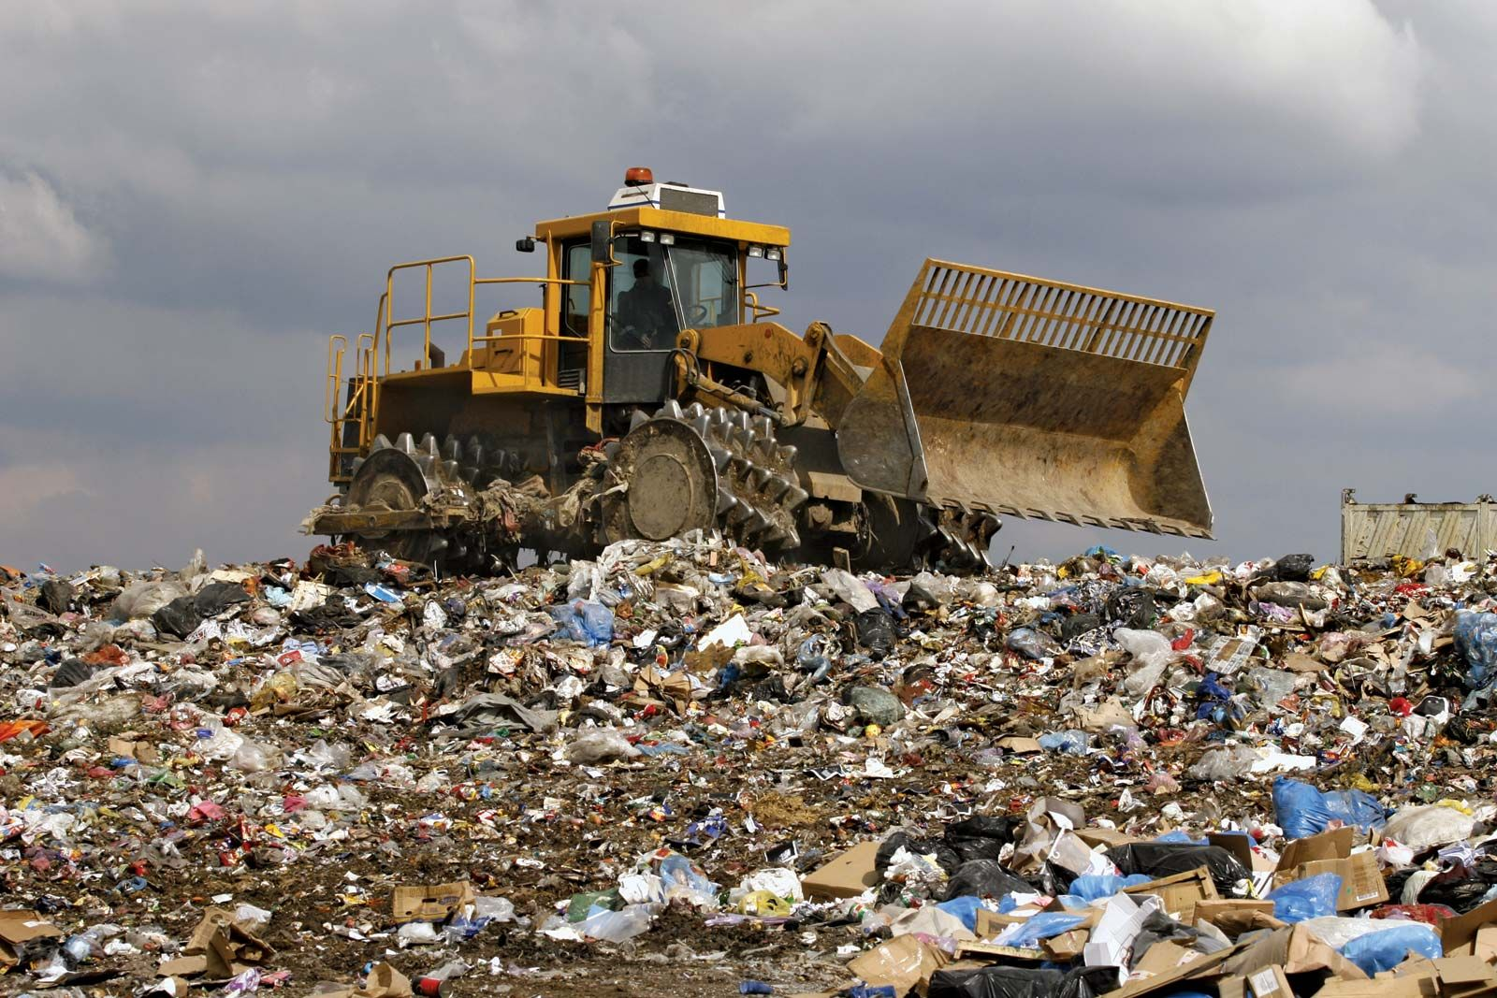
Stephen Covey’s Time Matrix
Quadrant Four
WASTE!

Slide 22
 | Time Matrix
 | Urgent | Not Urgent
Important | I CRISIS: Manage (5%) Crisis Medical emergencies Last minute preparations for scheduled activities | II FOCUS: Big Rocks (75%) Preparation/Planning Large chunks of 'big rock' work Clarifying values: what will move the needle? Exercise Relationship-building True relaxation and recreation
Not Important | III DECEPTION: Avoid (15%) Some meetings Constantly turning to emails 'Pressing'…to other people Interruptions Boss musing to you Projects that feel important but don't move the needle | IV WASTE: Limit (5%) Busy work Social Media Excessive socializing or relaxing Trivia People wasting your time

Slide 23
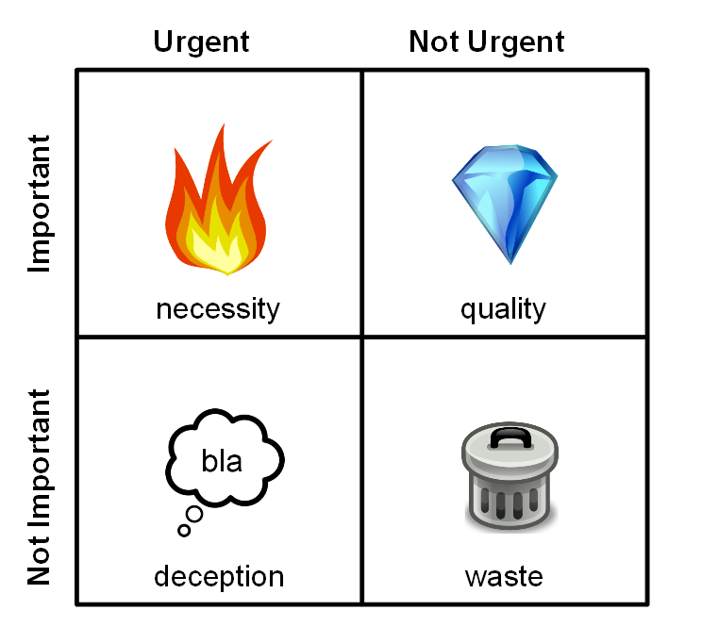
Visuals
Notes:
Find these on the internet

Slide 24

What did you learn?

Slide 25
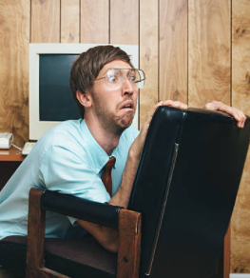





Email* (*and Teams. And Slack. And texting. And….)

Slide 26

How often do you check email?
You are working alone. You have 1-3 hours with no meetings. How often will you check your email?
After every task
Every few minutes
About four times an hour
About once an hour
Every few hours
Notes:
Raise you hand for the answer….who says A?....

Slide 27

The Urgency Effect:
Even if we know a larger,
less-urgent task is vastly
more consequential, we will
instinctively choose to do a smaller, urgent task anyway.
OUR BRAINS TRICK US!
Scheduling donor visits
Notes:
Thanks for nothing, Brain!!!

Slide 28
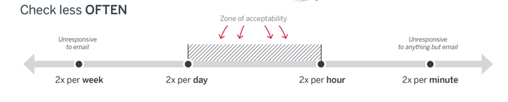
Notes:
Walk through the suggested max and minimum

Slide 29
Combatting Your Email Addiction (the urgency effect)
Check email ONLY
… during ‘stub’ times
… between ‘big rocks’
… at set times during the day. Schedule it.

Slide 30
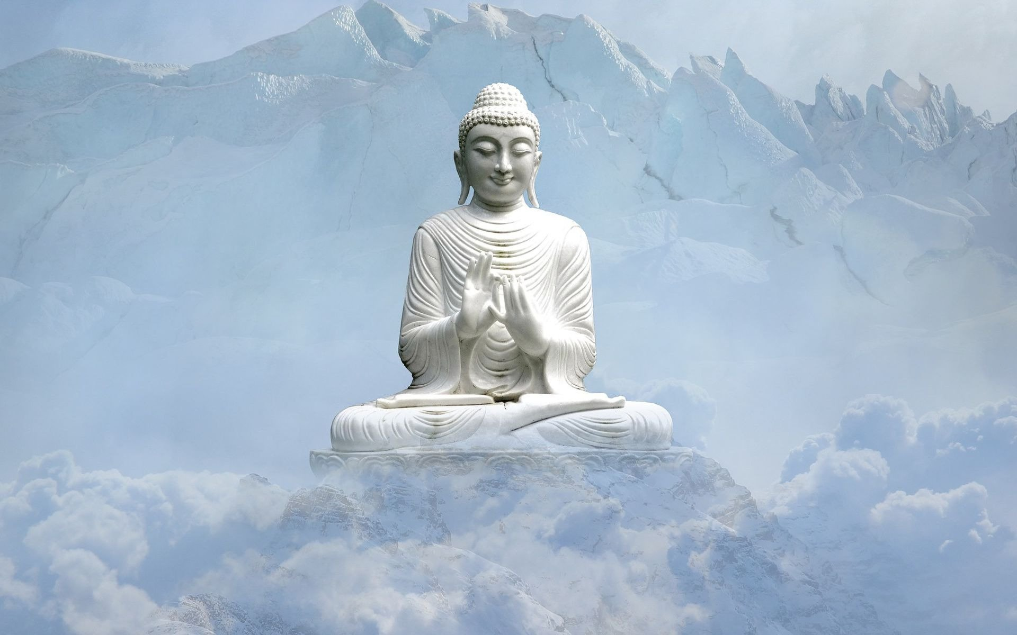
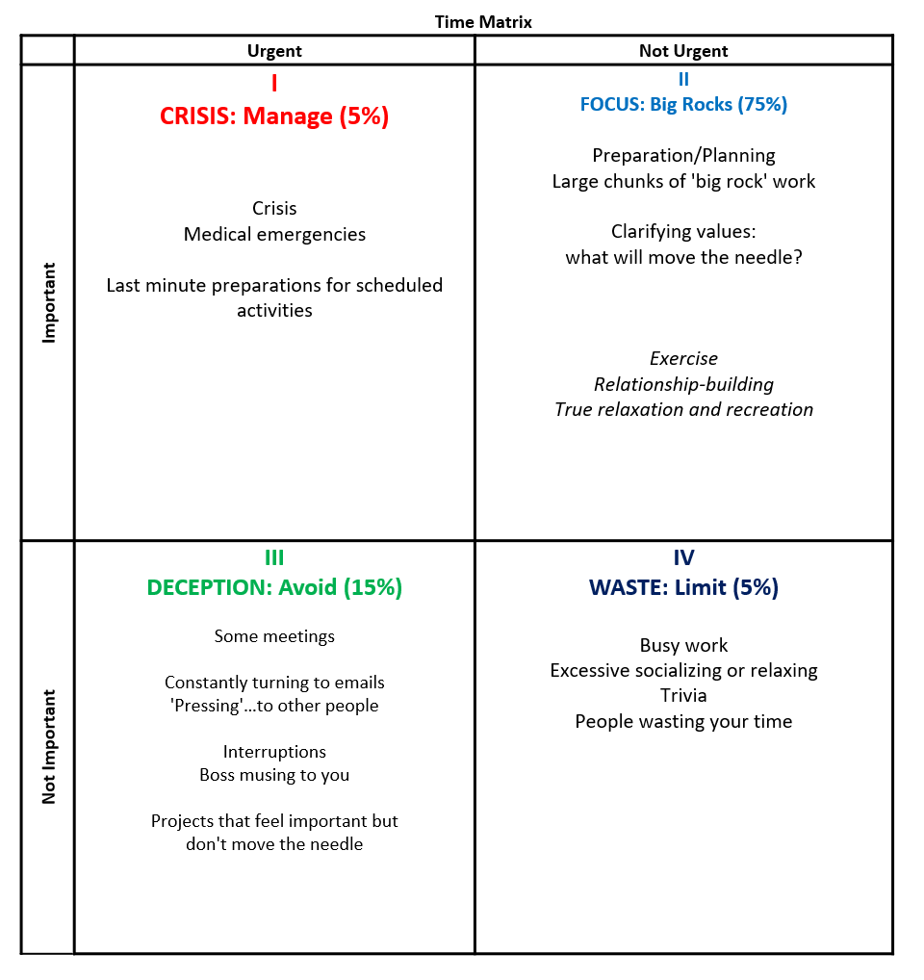
Reaching Time Nirvana
Um…how do we get there?

Slide 31
 | Time Matrix
 | Urgent | Not Urgent
Important | I CRISIS: Manage (5%) Crisis Medical emergencies Last minute preparations for scheduled activities | II FOCUS: Big Rocks (75%) Preparation/Planning Large chunks of 'big rock' work Clarifying values: what will move the needle? Exercise Relationship-building True relaxation and recreation
Not Important | III DECEPTION: Avoid (15%) Some meetings Constantly turning to emails 'Pressing'…to other people Interruptions Boss musing to you Projects that feel important but don't move the needle | IV WASTE: Limit (5%) Busy work Excessive socializing or relaxing Trivia People wasting your time
Notes:
It’s applying all these principles

Slide 32
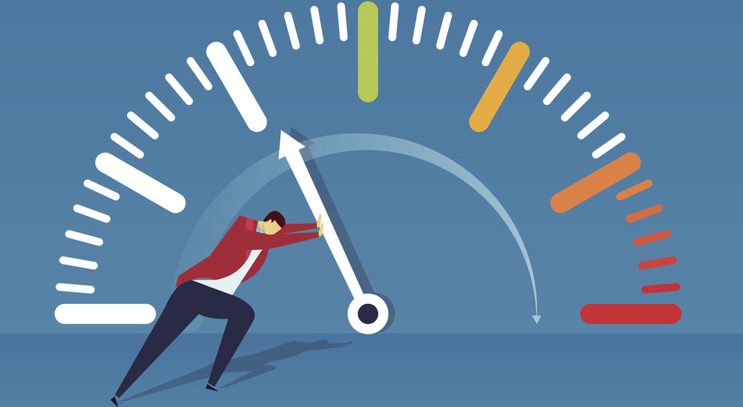

3-5 bullet points
What did you spend your precious time DOING?
What’s going to make you successful?
Notes:
Remember this? What is going to move the needle for you?what do you need to be spending your time on instead of meetings and email to get that glowing review? Then, work….

Slide 33
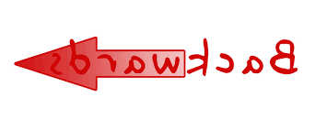
Notes:
Work BACKWARDS

Slide 34
2 hours a week calling/emailing for visits
3-4 visits/week
13 visits/month
120 visits/year
$500K

Slide 35
2 hours a week calling/emailing for visits
3-4 visits/week
120 visits/year
$500K
13 visits/month

Slide 36
2 hours a week calling/emailing for visits
3-4 visits/week
13 visits/month
120 visits/year
$500K

Slide 37
2 hours a week calling/emailing for visits
3-4 visits/week
13 visits/month
120 visits/year
$500K

Slide 38
2 hours a week calling/emailing for visits
3-4 visits/week
13 visits/month
120 visits/year
$500K

Slide 39
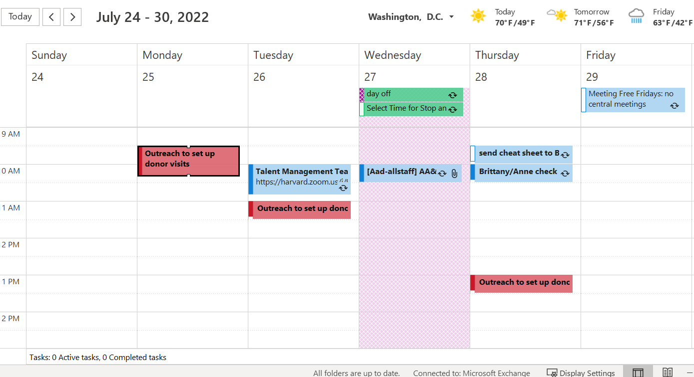
Notes:
Chunk out big rock time to do that work that will lead to success.

Slide 40

Pair Shares! (5 mins)
Share your 3-5 Big Rocks.
Discuss ONE of them: what do you need do to make that rock a reality? How will you plan your work then work your plan to make that happen?
Notes:
5 minute pair share
Pair them up: counting around table or 1-2 1-2….

Slide 41
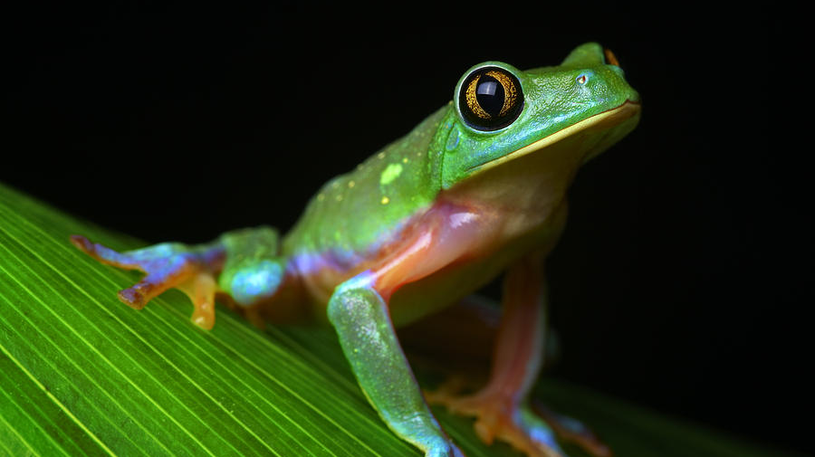
If it’s your job to eat a frog, do it first thing in the morning.
If it’s your job to eat TWO frogs, eat the larger one first.

Slide 42
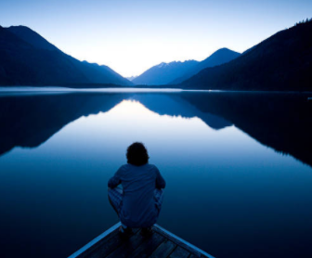
Write 3 commitments to help you use time well
List them on paper
Show them to your manager
Work on them for the next SIX weeks (new habits take about 4 weeks)

Slide 43

Bonus tracks!

Slide 44
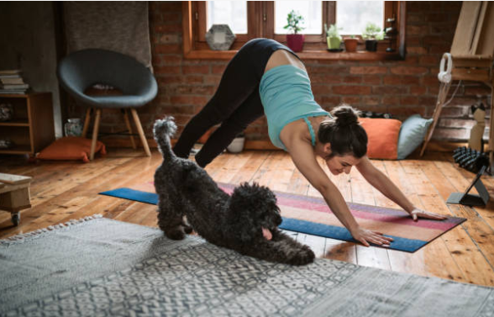
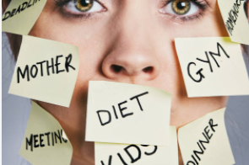


Notes:
How can you make more time for the things you want in life?

Slide 45
What can you do to ‘make’ more time to do the things you want in your personal life to have a better work-life balance?
Get to bed 1 hour earlier (stop scrolling on phone) and get up an hour earlier to exercise
Eat eggs and toast for dinner and pizza another night so you have 2 more hours to work on my book/art/cartoons/puzzles
Pay a housekeeper to clean so you have 3 more hours on the weekend to work on your side hustle
Notes:
Ask audience for suggestions BEFORE you click in 3 answers.

Slide 46
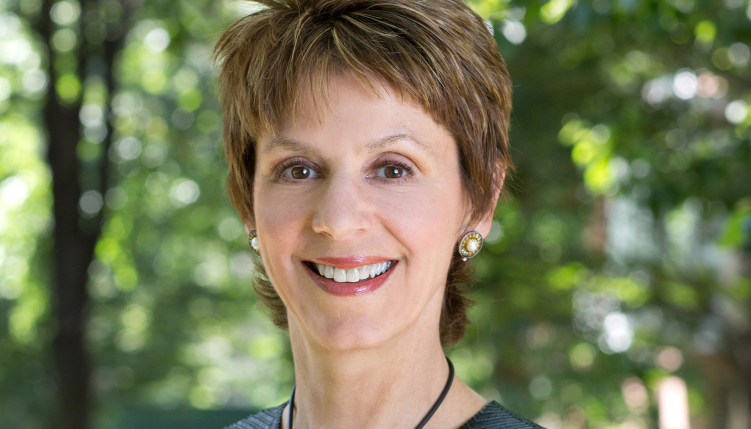
Anne T. Melvin
Dynamic Fundraising Training
AnneMelvin@DynamicFundraisingTraining.com

