Slide 1
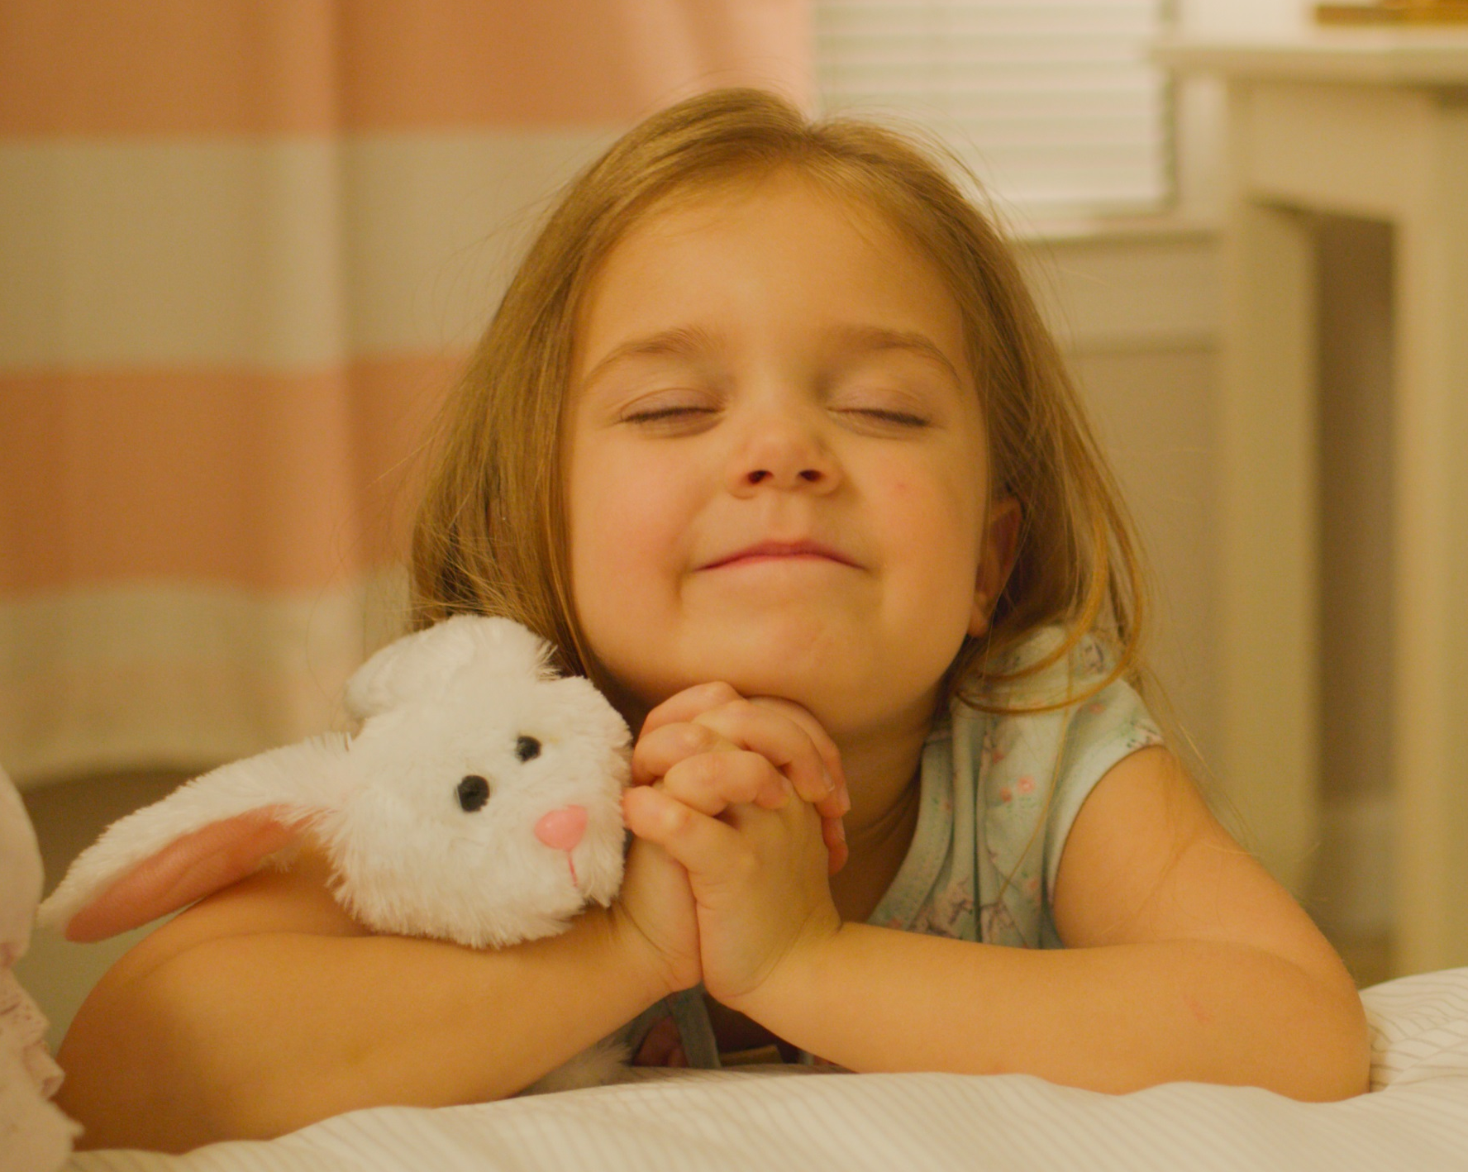

Give Your Best Gift
Become like a child…. Matthew 18:3
Notes:
Talk about estate planning
Talk very little about the various tools of estate planning, like wills and trust, but rather I’d like to share some thoughts and ideas that will help you use your estate plan to give your best gift.
Approach it from a broader perspective than just “Whose gonna get my stuff?”

Slide 2
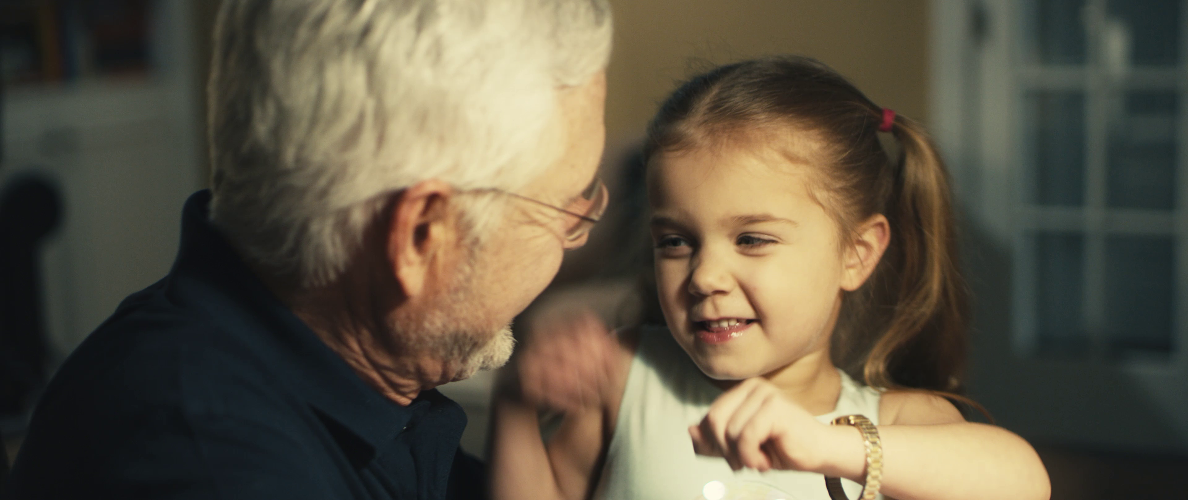
Give Your Best Gift
Notes:
First I’d like to show a video that the PGTRS Department along with Adventist Review TV produced that has to do with having a plan. (Click on the Picture to be taken to the willplan.org website where the video is uploaded)
Some of you may have seen this already when Dennis Carlson led worship on Monday, if you have seen it please refrain from sharing any spoilers with your neighbors
Hopefully after seeing this video you all want to rush out right away and create your own estate plan

Slide 3

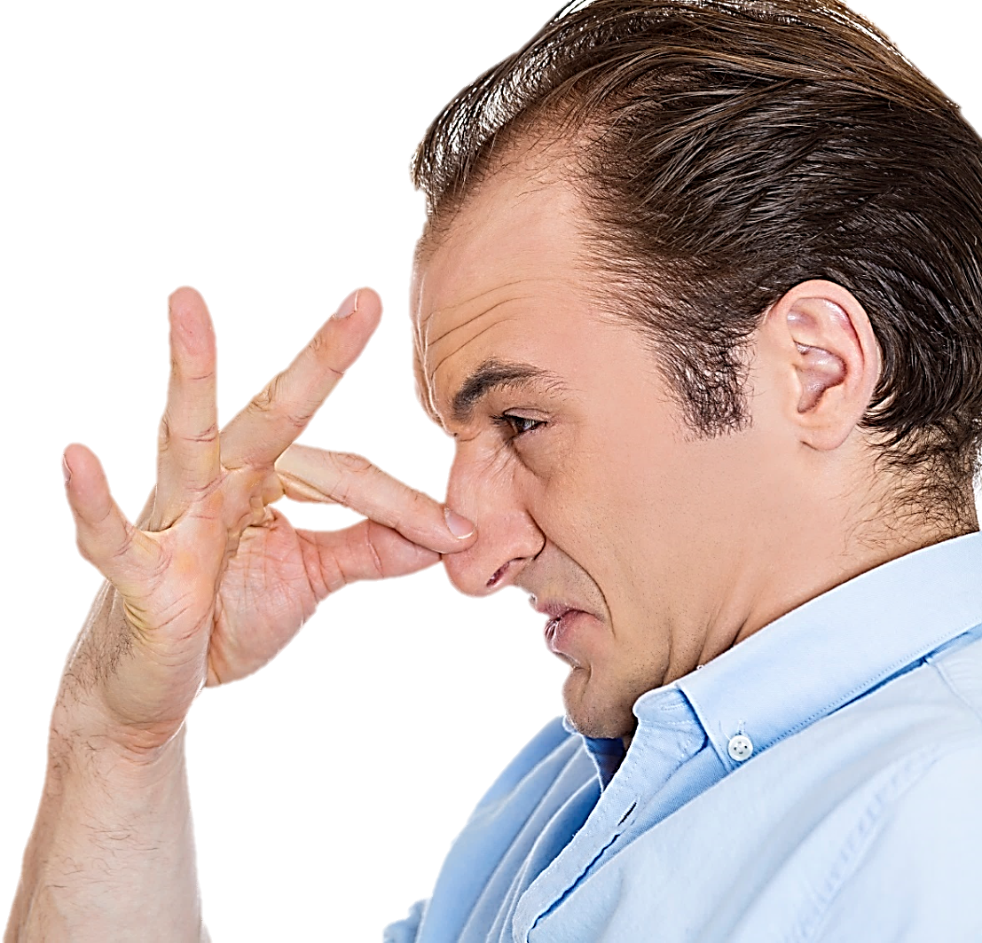
*
*Everyone needs a plan, even non U.S. Citizens living in the U.S.
Notes:
But if you are anything like most people making a will or a trust is very low on your “To-do List”
We all know we should put an estate plan in place, but it’s kinda like eating your vegetables or getting your annual physical…. Often times it’s not something you look forward to
In fact many people find any reason they can to avoid planning their estate, like cleaning out their gutters…. Or darning socks….
Perhaps that is because many people think of estate planning in transactional terms
Oh… and everyone needs a plan.

Slide 4
3 Opportunities
Estate Planning Affords
Bestow Blessings
Serve Loved Ones
Demonstrate Values
Notes:
Estate Planning provides opportunities
Estate only matures once
Estate planning deeply personal
Depends on your circumstances
Worked through with an attorney
Will give information on how you can get help at the end of the presentation
As you can see the opportunities I’ll be talking about today are
Bestow Blessings
Serve Others
Demonstrate Values

Slide 5
Bestow Blessings -
Provide a final material blessing to the people you love and the organizations you support.
Bestow a financial gift that will make a meaningful impact on the mission of an organization
Transfer family heirlooms that have significant sentimental value
Notes:
Through your estate plan this is your last opportunity to bestow blessings.
Did you notice how happy little Susie was while she was passing out her goodies? She had a huge smile on her face and I think this is an excellent depiction of how it is more blessed to give than to receive.
When we give during life we are held back in our giving because of having to take care of our own needs…. When we give through our estate our needs are no longer a factor and we can give gifts that will make a more meaningful impact
By passing on family heirlooms we are also passing on memories, and ensuring that our loved ones are not forgotten. When little Susie looks at the watch her Grandpa gave her don’t you think she will be brought back to memories of him?

Slide 6

For Consideration
Who and what takes priority in your life?
What do you want to accomplish by giving a bequest?
What is an appropriate amount to accomplish your goal?
Notes:
When considering the blessings you want to bestow through your estate plan here are a few things to consider that may help you enrich your blessings

Slide 7
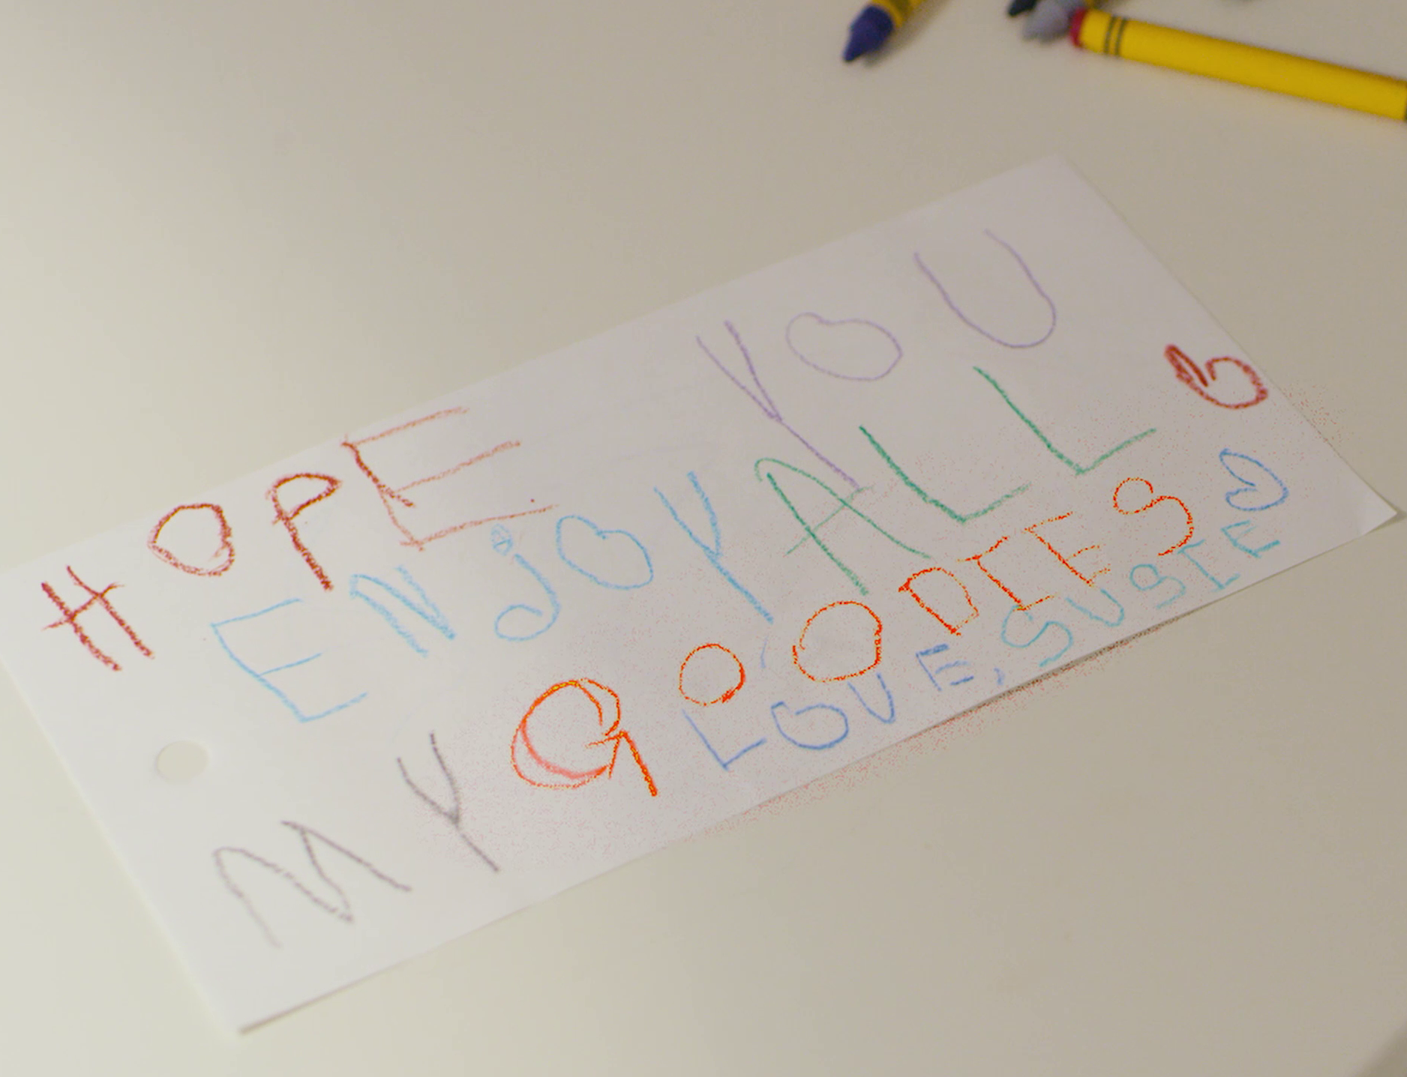
Serve Loved Ones –
Provide an orderly estate where information is readily available and instructions are clearly given
Allow loved ones to grieve your loss without the distraction of legal and financial issues
Notes:
Susie gave her own instructions, didn’t she…. You may be able to see here she said “Enjoy all my Goodies”…..

Slide 8
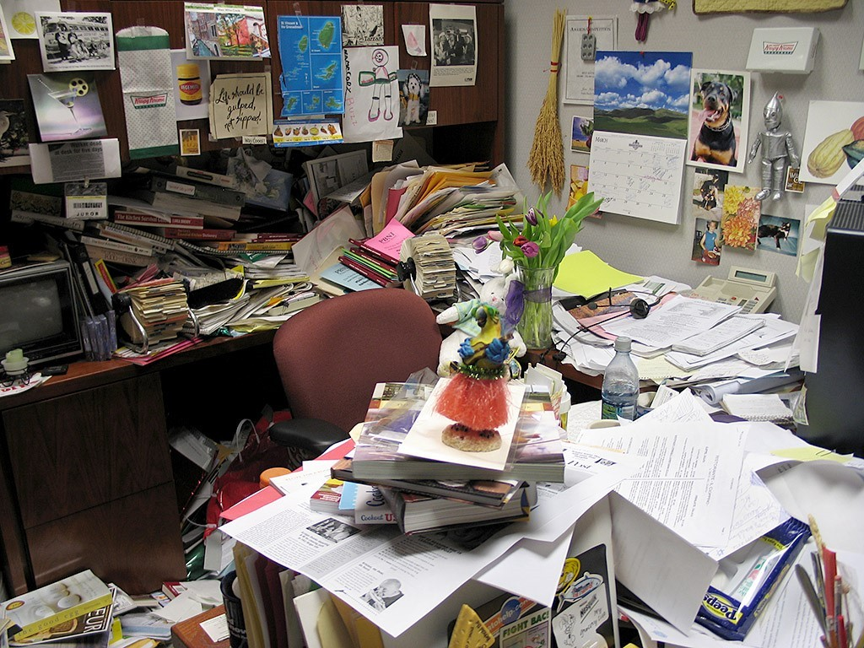
Don’t Be This Guy
Notes:
When I was a financial Advisor
Had a client I met with one time – he gave me some basic information about his assets
He never returned my calls
His daughter called me to let me know he passed away
She had very little information about his estate, what he owned, where everything was
I helped her as best I could

Slide 9

For Consideration
Should restrictions accompany the bequests?
Would it be beneficial to discuss your plans with beneficiaries?

Slide 10
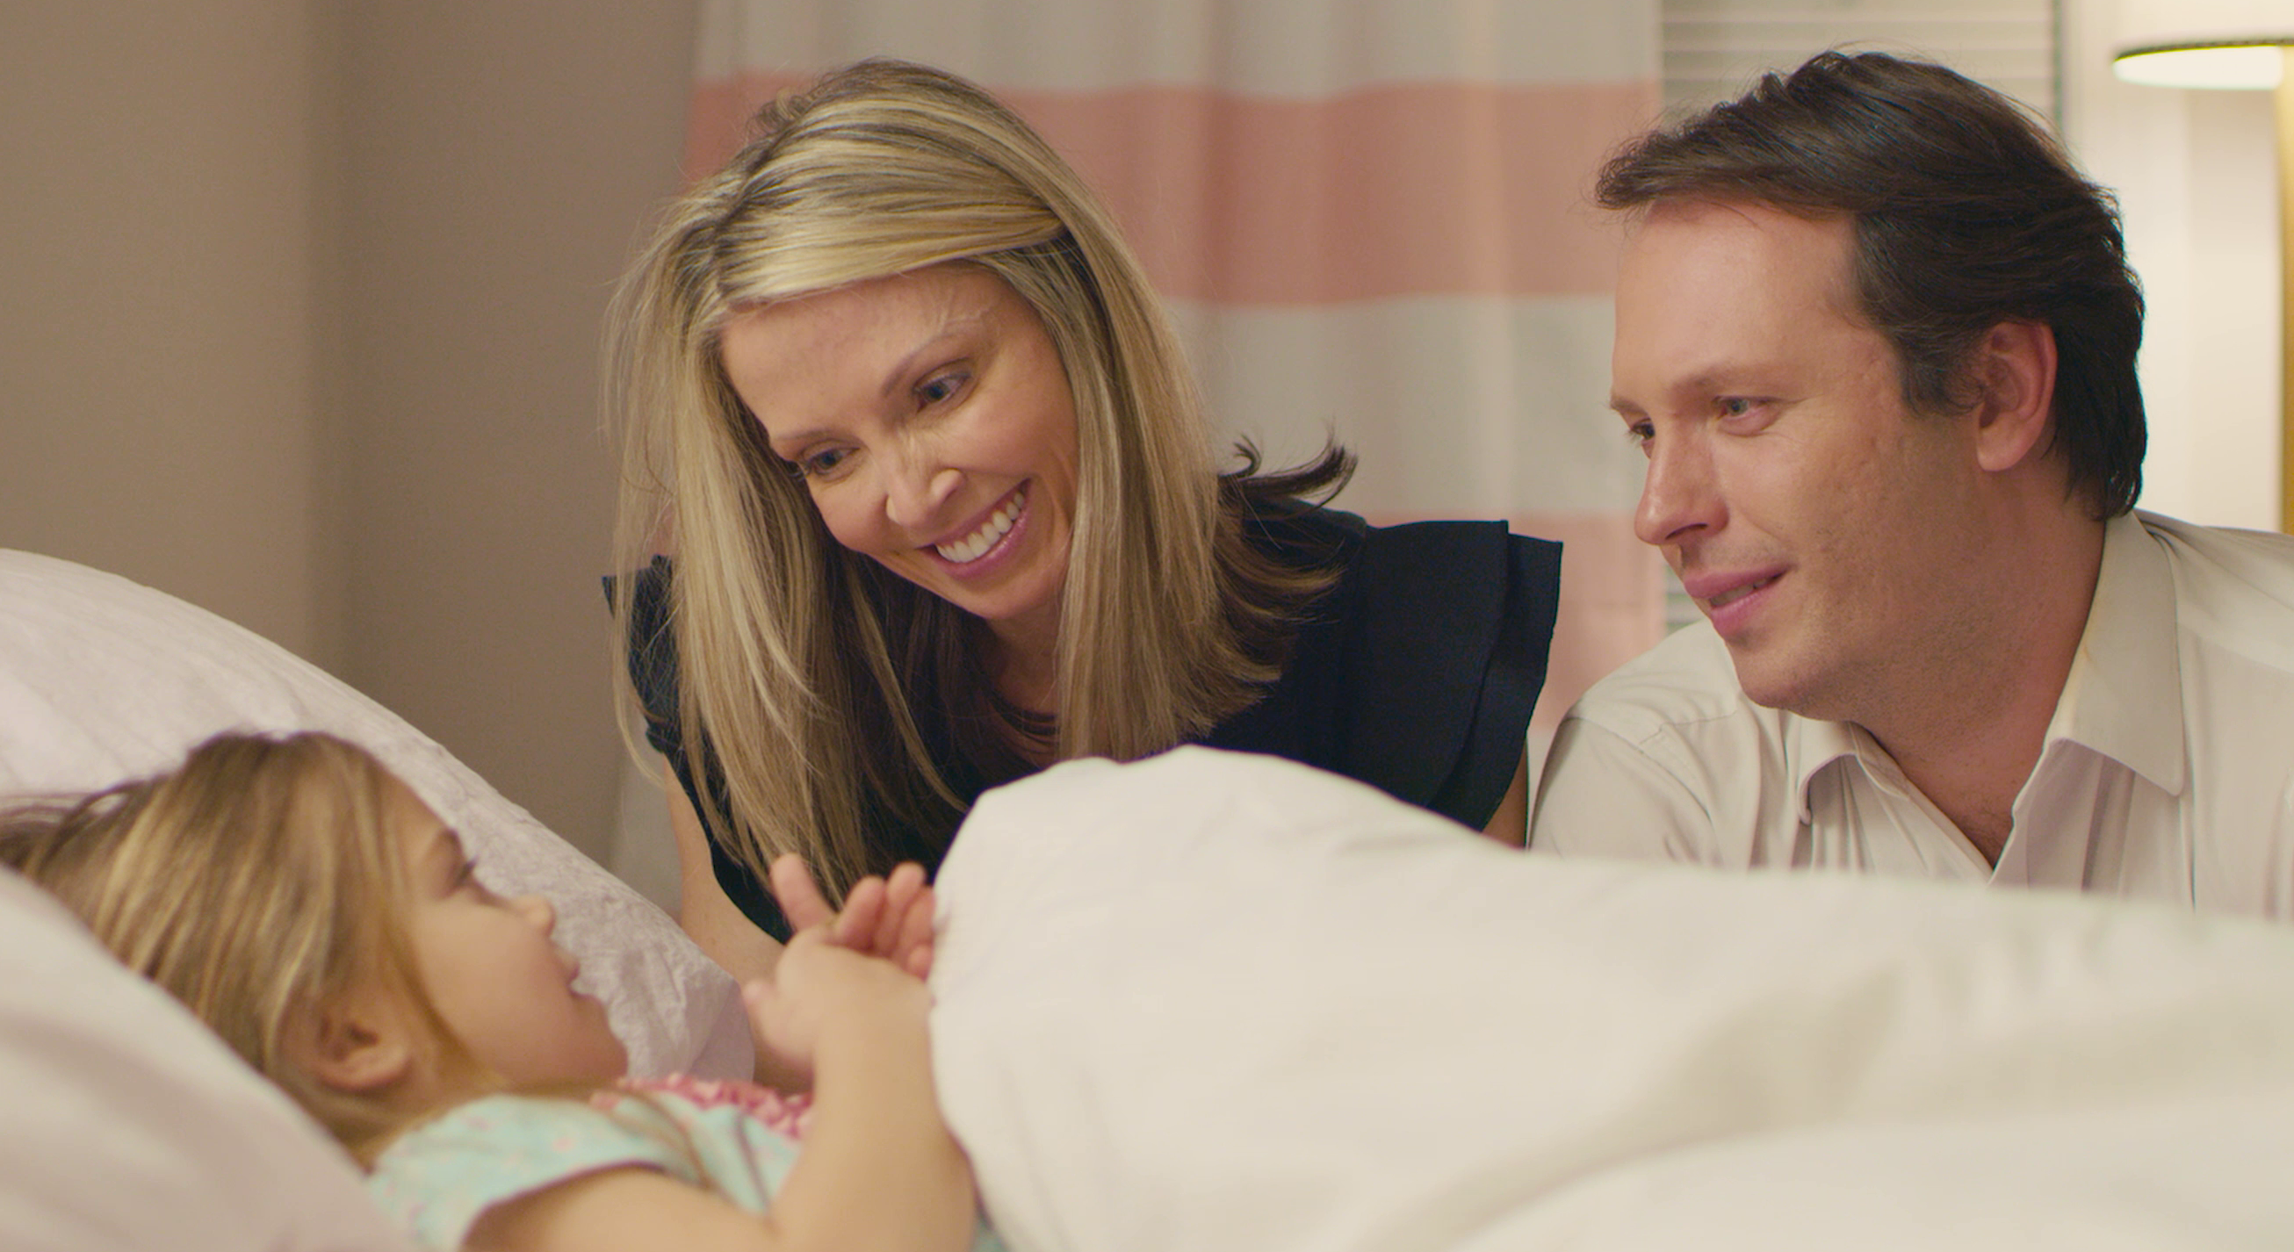
Demonstrate Values –
Clearly demonstrate the moral values that guide your life through the gifts you give at your death
Set an example for your loved ones that are based on Godly principles
Pass on your values to the next generation through your gifts
Notes:
Little Susie demonstrated her values by giving her worldly goods, her most prized possessions, to her family members
She even made sure her pet hamster was taken care of by giving the hamster to her sister
Then she gave everything else that she hadn’t given away to God
Susie’s parents could easily see their daughters values and I’m sure it would make an impact on them

Slide 11
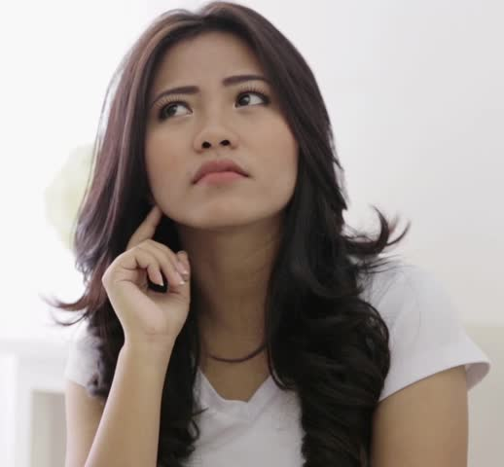
For Consideration
What will have a greater chance of passing on values?
  A one time immediate gift
  An ongoing stream of income
  An endowment

Slide 12
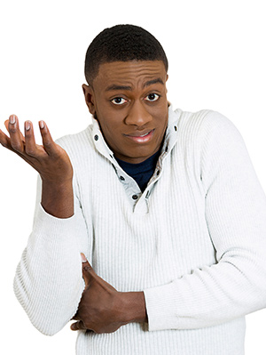
But Where Can I Get Some Help?

Slide 14
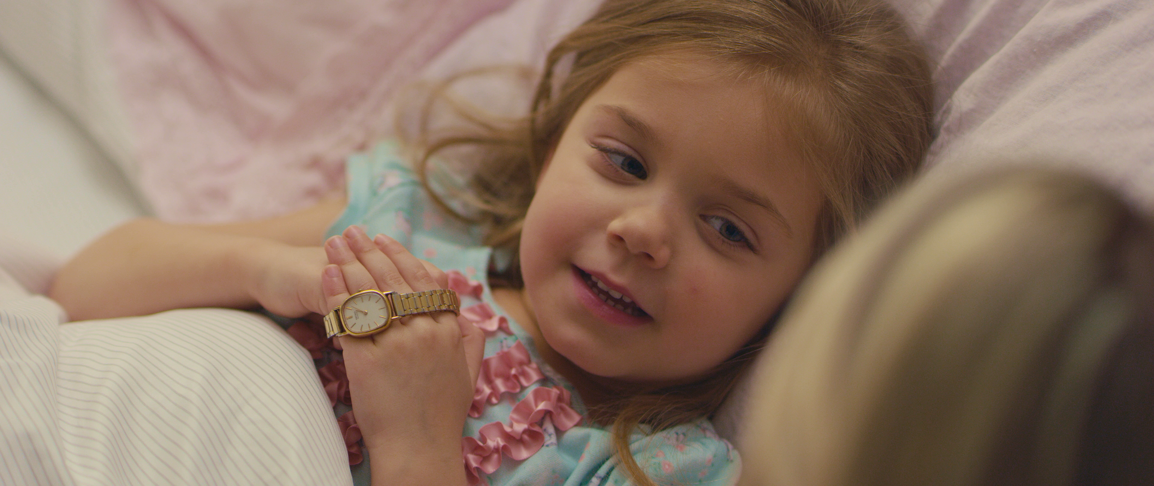
Thank you!

