Slide 1
PLANNED GIVING IN SCRIPTURE
Planned Giving & Trust Services
2018

Slide 2
PLANNED GIVING & TRUST SERVICES TEAM
Notes:
Dennis, Gwen, Meridith, and Scot
All are certified in PGTS

Slide 3
PLANNED GIVING IN SCRIPTURE
Planned Giving & Trust Services
2018
Notes:
Planned Giving has existed before death became a part of human existence on planet earth.

Slide 4
BEFORE SIN GOD PLANNED
Notes:
God had a plan in place before the earth was created. God planned the Gift of His own Son if a rescue plan to save humanity was needed.
Eph 1:4-5 GNB Even before the world was made, God had already chosen us to be his through our union with Christ, so that we would be holy and without fault before him. Because of his love (5) God had already decided that through Jesus Christ he would make us his children---this was his pleasure and purpose.
Rev 13:8 (last part) Book of Life of the Lamb slain from the foundation of the world.

Slide 5
AFTER SIN PLAN ANNOUNCED
Notes:
When Adam and Eve chose to disbelieve GOD the plan was revealed to them.
Gen 3:15 GNB (15) I will make you and the woman hate each other; her offspring and yours will always be enemies. Her offspring will crush your head, and you will bite her offspring's heel."

Slide 6
FIRST NEED FOR A PLAN
Notes:
Abel left home with the intent to return after he offered his sacrifice to God. He did not return alive. The Bible does not tell us about his plan but at the point of his death his planning was complete.
Abel was the first human whose plan had to be implemented. All of Abel’s possessions had to be transferred to others. Abel’s stewardship to God was over and had to be transferred either to his wife or to his children.
Hebrews 11:4 NKJV
(4) By faith Abel offered to God a more excellent sacrifice than Cain, through which he obtained witness that he was righteous, God testifying of his gifts; and through it he being dead still speaks.

Slide 7
NOAH & SHEM
Notes:
Hebrews 11:7 NKJV
(7) By faith Noah, being divinely warned of things not yet seen, moved with godly fear, prepared an ark for the saving of his household, by which he condemned the world and became heir of the righteousness which is according to faith.

Slide 8
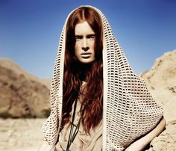
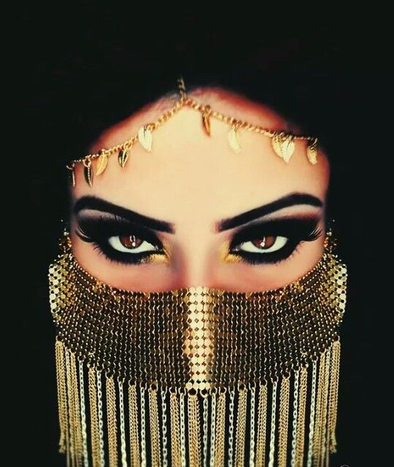
JOB
Notes:
Job second three daughters are mentioned in scripture by name. These women were astute business persons. Job would not have given them part of his possessions if they were not faithful to God and good stewards. Job was a faithful steward and I am sure that he would only give God’s possessions to his children who were faithful to God.
Job 42:12-17 GNB (12) The LORD blessed the last part of Job's life even more than he had blessed the first. Job owned fourteen thousand sheep, six thousand camels, two thousand head of cattle, and one thousand donkeys. (13) He was the father of seven sons and three daughters. (14) He called the oldest daughter Jemimah (White Dove), the second Keziah (Cassia, sweet scented cinnamon powder), and the youngest Keren Happuch (Horn of black mineral powder used for eye makeup). (15) There were no other women in the whole world as beautiful as Job's daughters. Their father gave them a share of the inheritance along with their brothers.

Slide 9
FIRST PLANNED GIVING
Notes:
Planned giving has never been easy. Abram was not happy:
Principle #1
God owns it all. We need to seek God’s will for HIS asset.
Gen 15:1 After all these things happened, the word of the LORD came to Abram in a vision. God said, "Abram, don't be afraid. I will defend you and give you a great reward."
Gen 15:2 But Abram said, "Lord GOD, there is nothing you can give me that will make me happy, because I have no son. My servant Eliezer from Damascus will get everything I own after I die."
Gen 15:3 Abram said, "You have given me no son, so a servant born in my house will get everything I have."
Gen 15:4 Then the LORD spoke to Abram and said, "That servant will not be the one to get what you have. You will have a son who will get everything you own."
Our plan may not always be God’s plan.

Slide 10
SARAH’S PLAN
Notes:
Gen 21:14-21 GNB Early the next morning Abraham gave Hagar some food and a leather bag full of water. He put the child on her back and sent her away. She left and wandered about in the wilderness of Beersheba. (15) When the water was all gone, she left the child under a bush (16) and sat down about a hundred yards away. She said to herself, "I can't bear to see my child die." While she was sitting there, she began to cry. (17) God heard the boy crying, and from heaven the angel of God spoke to Hagar, "What are you troubled about, Hagar? Don't be afraid. God has heard the boy crying. (18) Get up, go and pick him up, and comfort him. I will make a great nation out of his descendants." (19) Then God opened her eyes, and she saw a well. She went and filled the leather bag with water and gave some to the boy. (20) God was with the boy as he grew up; he lived in the wilderness of Paran and became a skillful hunter. (21) His mother got an Egyptian wife for him.

Slide 11
ABRAM RISKED THE PLAN
Notes:
Abram's faith tested 100% when he was told to sacrifice the promised son, Isaac, heir to the all the possessions.
Even though we do not understand how God will work things out, we need to trust Him to do so as we move forward following God’s clear instruction.
Isaac’s faith was also tested here since he could resisted and escaped from his old father.
Through Abram’s faithful trust in God he was named Abraham, father of the faithful.

Slide 12
ISAAC PLANNED INHERITANCE
Notes:
Principle #2
We need to plan when we are young, strong, and mentally able. Waiting until we are old and feeble is not a good thing.
Jacob steals his brother Esau's inheritance. Yet Esau did not value the spiritual bequest. It was worth less than a bowl of lentils.
Conflict may result if we wait until we are old to make our plan.

Slide 13
JACOB REVEALING THE PLAN
Notes:
Jacob prophecies the inheritance of each of his sons.
Jacob was a prophet and God revealed the plan and the future of the heirs of the possessions.

Slide 14
JACOB'S BLESSING PLAN
Notes:
Principal #3
Follow God's will even though family does not agree.
Jacob blessing Joseph's two son., Ephraim (younger) and Manassas. Joseph had very carefully placed these two boys in front of his father, the older on his fathers right hand and the younger on the left.. Jacob crosses his hands and put the younger, Ephraim ahead of the older even over Joseph's objection.
Gen 41:50-51 GNB Before the years of famine came, Joseph had two sons by Asenath. (51) He said, "God has made me forget all my sufferings and all my father's family"; so he named his first son Manasseh.

Slide 15
DAVID'S PLAN FOR SOLOMON
Notes:
Principle #4
If you do not make your own plan, others will plan for you.
David had to hastily plan a coronation of Solomon to stop another son from becoming king.
Make your plan now!
1 Kings 1:11 NKJV
(11) So Nathan spoke to Bathsheba the mother of Solomon, saying, "Have you not heard that Adonijah the son of Haggith has become king, and David our lord does not know it?

Slide 16
JESUS PLANNED
Notes:
Jesus was the original planned gift.
Jesus also had His own plan for the care of His mother on the cross.
Joh 19:26 When Jesus saw his mother and the disciple whom he loved standing nearby, he said to his mother, "Woman, behold, your son!"
Joh 19:27 Then he said to the disciple, "Behold, your mother!" And from that hour the disciple took her to his own home.
Jesus Last Will and Testament includes you.
Joh 14:27 "I leave you peace. It is my own peace I give you. I give you peace in a different way than the world does. So don't be troubled. Don't be afraid.
Principle #5
With God’s wisdom your Will can make difference in the future.

Slide 17
In the trust given to the first disciples, each believer has a share. Each one is to be an executor of the Savior's will.
Last Will & Testament of Christ
The Review and Herald, January 7, 1902.
Notes:
This is an IRREVOCABLE TRUST
Executors of the Saviour’s Will
Christ loves the human race; and in every action of His life He has expressed this love. He calls upon men to love one another as He has loved them. His saving power and love are ever to be the theme of those who believe in God.
Just before His ascension, He gave to His disciples the commission. “Go ye therefore, and teach all nations, baptizing them in the name of the Father, and of the Son, and of the Holy Ghost: teaching them to observe all things whatsoever I have commanded you: and, lo, I am with you always, even unto the end of the world.” (Mt 28:19-20)
Thus was given to the disciples a most precious trust. They were to be the executors of the will in which Christ has bequeathed to the world the treasure of eternal life. They realized the responsibility of their work. They knew that they held in their hands the bread of life for a famishing world, and they went everywhere preaching the word. The love of Christ constrained them, and they could not forbear breaking the bread of life to all who were in need. The last words of the Saviour were constantly sounding in their ears.
In the trust given to the first disciples, each believer has a share. Each one is to be an executor of the Saviour’s will. Each one has been given sacred truth to give to the earnest seeker. Every believer is to be a laborer together with God.—The Review and Herald, January 7, 1902.
White, E. G. (1990). The Retirement Years (p. 100). Review and Herald Publishing Association.
White, E. G. (1990). The Retirement Years (p. 100). Review and Herald Publishing Association.
As SDA Church organization in SPD and around the world we need to help our people be faithful to God in their PLANNED GIVING.

Slide 18
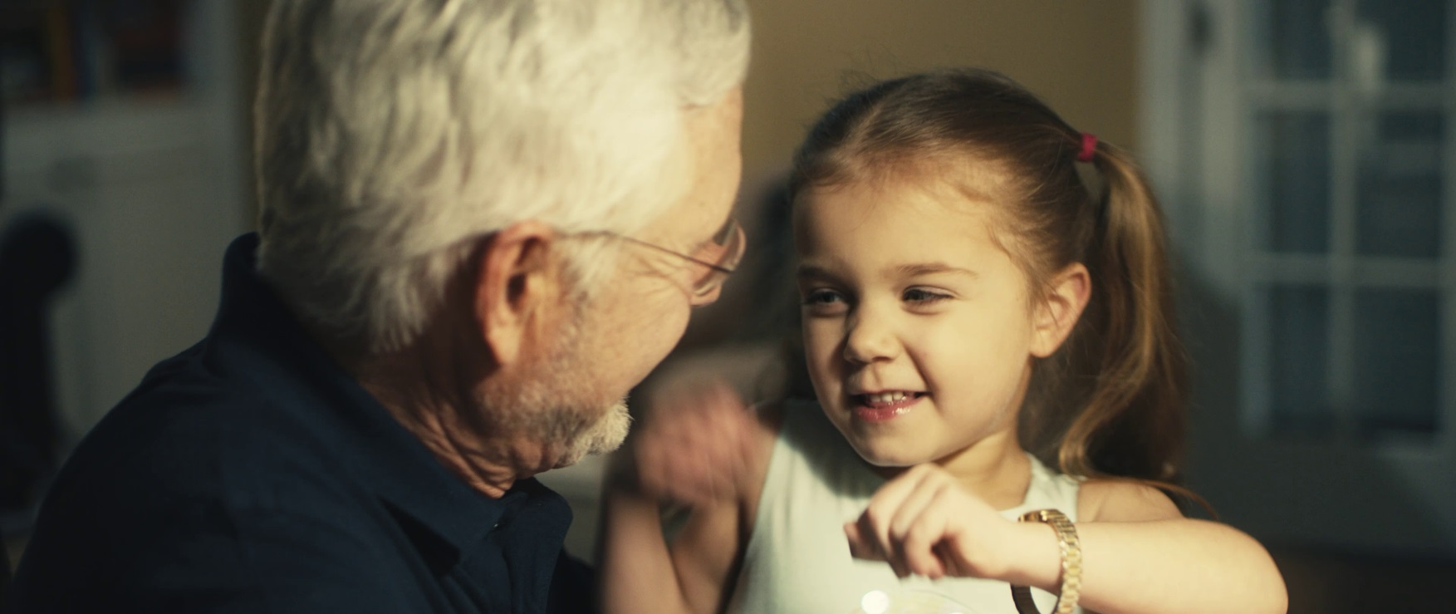
GIVE YOUR BEST GIFT
Notes:
Click on the picture to be taken to the willplan.org website where the video is uploaded.

Slide 19
EYES FOCUSED ON JESUS
Notes:
I encourage each person here this morning to faithfully make a plan as their crowning act of stewardship to honor God.
Seventh-day Adventists have chosen to make many reforms that go against the practices of the majority of their society and culture.
We are looking for and believe that Jesus will return to earth soon:
As a result we have made significant REFORMS in our beliefs, lives and actions.
In many courtiers of he world to be a Christian puts you out of step with the majority of the society that you live in (Buddhist, Hindu, and Muslim)
To be a protestant is a minority in some areas.
The day when we worship, Saturday rather than any other day of the week
What we believe about the Cosmic Conflict between evil and good, Satan and Jesus
We believe that sin is the primary problem on this earth
We believe that the TEN COMMANDMENT are still valid and should be kept
The Heavenly sanctuary and Jesus is our High Priest there now
That final judgement is now going on in Heaven.
Health practices that honor God in how we care for our Physical bodies
God owns everything including us and what we call our assets
This earth is not our home, we are pilgrims just passing through
What we believe about what happens when a person dies
SO WHY NOT ALSO REFORM HOW WE PLAN FOR DEATH? Seek to make a plan directed by God rather than our peers, society, or culture.
TOTAL MEMBER INVOLVEMENT
Every member needs a plan for their family.

